Slide 1
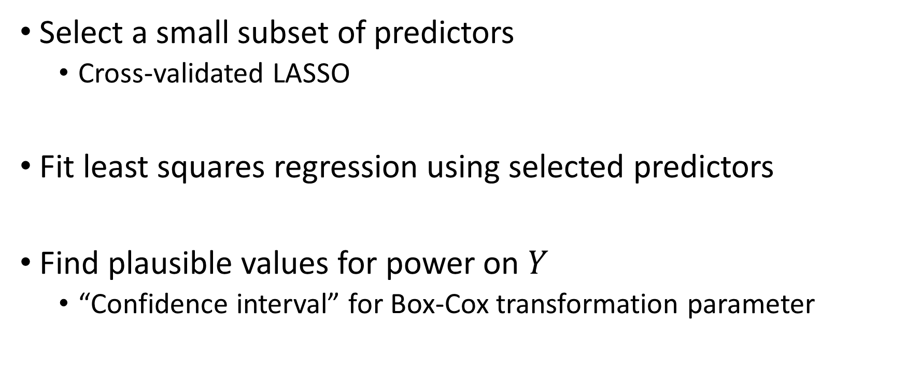
Riboflavin Data
Select a small subset of predictors
Cross-validated LASSO
Fit least squares regression using selected predictors
Find plausible values for power on $Y$
“Confidence interval” for Box-Cox transformation parameter
Notes:
Log corresponds to $Y^{0}$

Slide 2
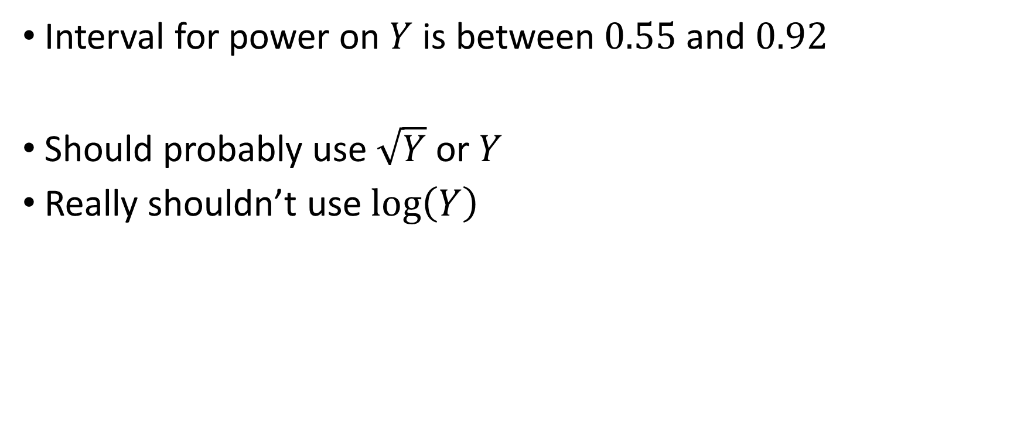
Riboflavin Data
Interval for power on $Y$ is between $0.55$ and $0.92$
Should probably use $\sqrt{Y}$ or $Y$
Really shouldn’t use $\log\left(Y\right)$

Slide 3
Riboflavin Data
Disclaimer: This isn’t inference!
Suggests that conventional wisdom may be wrong
Need a more principled approach

Slide 4
Box-Cox Inference
LS Box-Cox methodology gives confidence intervals
We can apply the same process with LASSO
Still a work in progress
Some empirical results

Slide 5
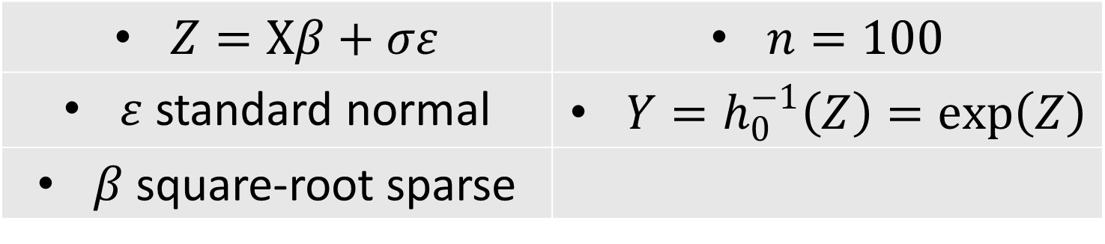

Box-Cox Inference
Maximize profile likelihood
Include all $γ$ with likelihood within $\sim 2$ of maximum
$Z=Xβ+σε$ | $n=100$
$ε$ standard normal | $Y=h_{0}^{−1}\left(Z\right)=\exp\left(Z\right)$
$β$ square-root sparse

Slide 6
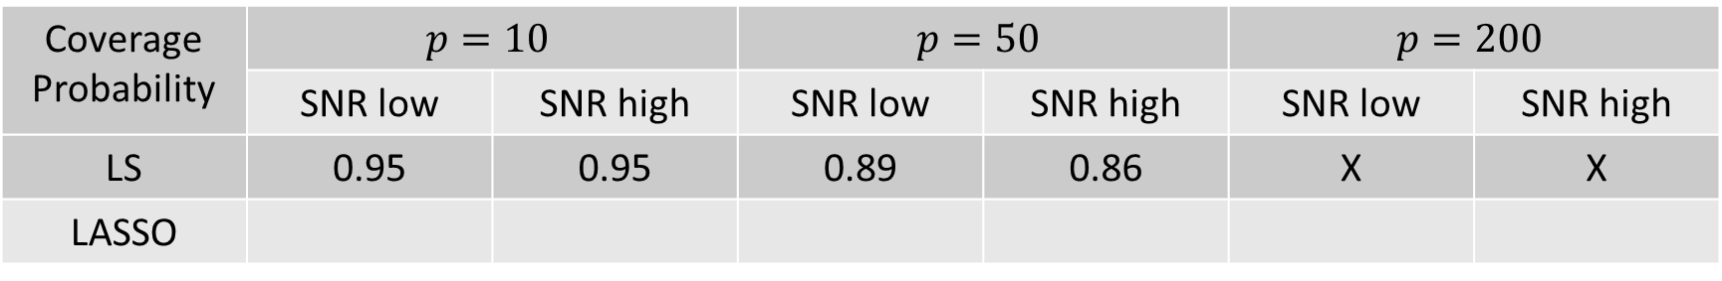
Box-Cox Inference
Coverage Probability | $$p=10$$ |  | $$p=50$$ |  | $$p=200$$
 | SNR low | SNR high | SNR low | SNR high | SNR low | SNR high
LS | 0.95 | 0.95 | 0.89 | 0.86 | X | X
LASSO
$Z=Xβ+σε$ | $n=100$
$ε$ standard normal | $Y=h_{0}^{−1}\left(Z\right)=\exp\left(Z\right)$
$β$ square-root sparse
Notes:
Low coverage prob

